Slide 1
Azure Kubernetes Service
Pradeep Kumar

Slide 2
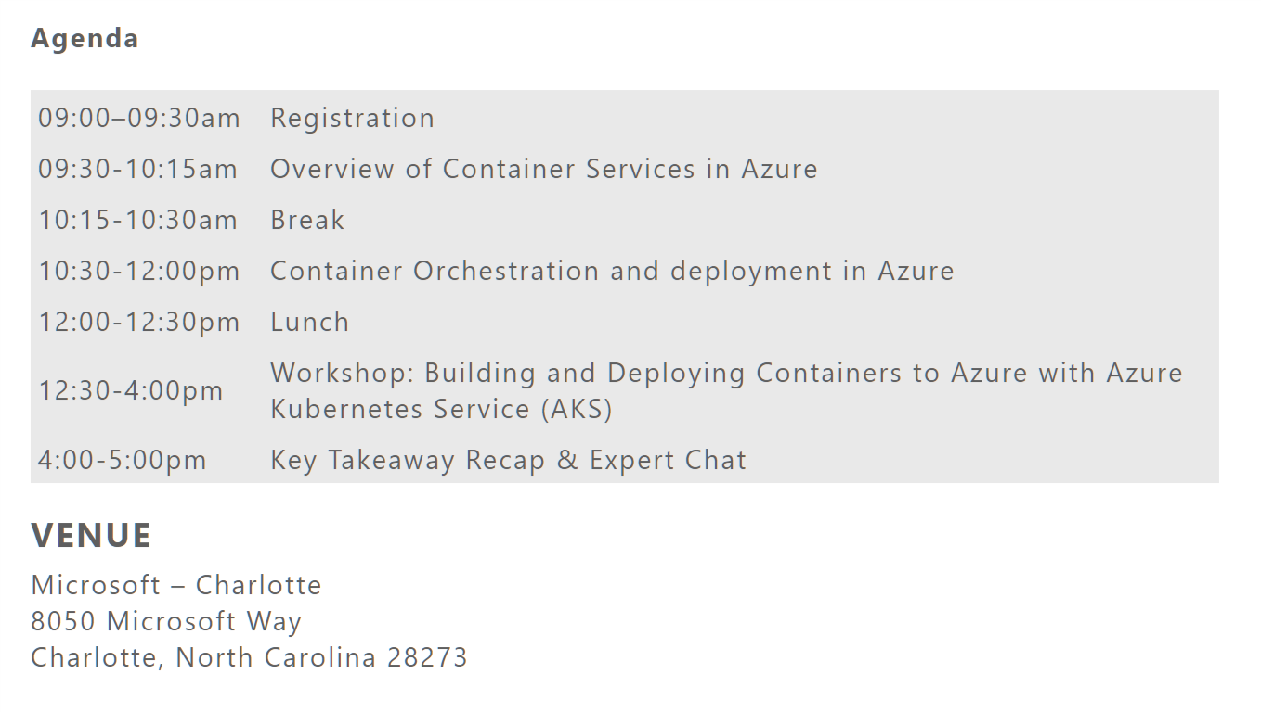

Slide 3
Presenter guidance
Title | Azure Kubernetes Service Overview
Main Object | Provide overview of Kubernetes on Azure and articulate the differentiators as well as benefits
Audience | TDMs, architects, OSS dev lead
Delivered by
Content Level | 200-300
Deck Owner | Stella Lin
Usage Guidance | 30 min presentation, 15 min demo, product deep dive is optional. Use after Containers on Azure overview deck.
Version | 1.5
NEXT: <next slide title>

Slide 4

Table of contents
Introduction
Top scenarios
Open source culture
Product deep dive
Azure Kubernetes Service Overview
Customer stories
Resources

Slide 5
https://aka.ms/newakslab
Register for Lab
AKS Hands-on Lab
https://aka.ms/aksdevops

Slide 6
Introduction
Introduction
Top scenarios
Open source culture
Product deep dive
Azure Kubernetes Service Overview
Customer stories
Resources

Slide 7
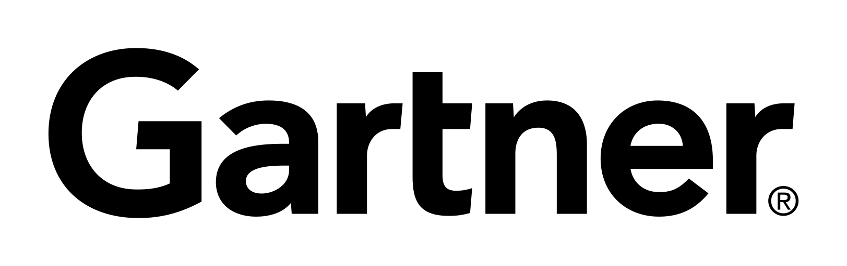
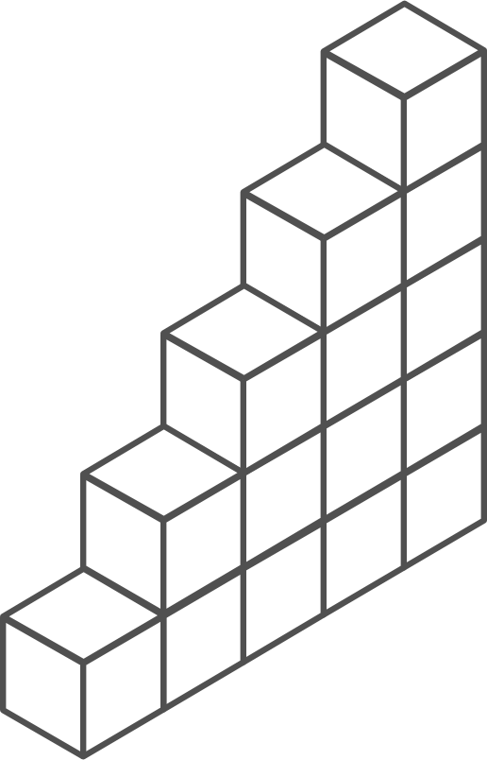
Containers and Kubernetes momentum
“By 2020, more than 50% of enterprises will run mission-critical, containerized cloud-native applications in production.”
Half of container environment is orchestrated.¹
77%
77% of companies² who use container orchestrators choose Kubernetes.
The average size of a container deployment has grown 75% in one year. ¹
Larger companies are leading the adoption.¹
75%
50%
Nearly 50% of organizations¹ running 1000 or more hosts have adopted containers.
¹ Datadog report: 8 Surprising Facts About Real Docker Adoption
² CNCF survey: cloud-native-technologies-scaling-production-applications

Slide 8
Kubernetes: the industry leading orchestrator
Portable
Public, private, hybrid, multi-cloud
Extensible
Modular, pluggable, hookable, composable
Self-healing
Auto-placement, auto-restart, auto-replication, auto-scaling

Slide 9
Kubernetes 101
Internet
Kubernetes control
Worker node
Kubernetes users communicate with API server and apply desired state
kubelet
kube-proxy
Master node
Docker
Master nodes actively enforce desired state on worker nodes
Prod
Prod
API server
Containers
Containers
Worker nodes support communication between containers
-controller-manager
-scheduler
Worker node
kubelet
kube-proxy
Worker nodes support communication from the Internet
replication, namespace, serviceaccounts, etc.
etcd
Docker
Prod
Prod
Containers
Containers

Slide 10
How managed Kubernetes on Azure works
Automated upgrades, patches
High reliability, availability
Easy, secure cluster scaling
Self-healing
API server monitoring
At no charge
Azure managed control plane
App/ workload definition
Self-managed master node(s)
Kubernetes API endpoint
etcd Store
User
API server
Scheduler
Controller Manager
Cloud Controller
Schedule pods over private tunnel
Customer VMs
Docker
Docker
Docker
Docker
Docker
Pods
Pods
Pods
Pods
Pods

Slide 11
From infrastructure to innovation
Managed Kubernetes empowers you to do more
Focus on your containers and code, not the plumbing of them
Responsibilities | DIY with Kubernetes | Managed Kubernetes on Azure
Containerization
Application iteration, debugging
CI/CD
Cluster hosting
Cluster upgrade
Patching
Scaling
Monitoring and logging
Customer
Microsoft

Slide 12
Kubernetes Resources
Replica Sets
&
Replication Controllers
Images, Pods & Containers
Daemon Sets
&
Jobs
StatefulSets
Volumes,
Secrets
&
Config maps
Deployments
&
Services
Namespace
&
Ingress

Slide 13
Publishing Services
ClusterIP
LoadBalancer
NodePort
ExternalName

Slide 14
Azure Kubernetes Service Overview
Introduction
Top scenarios
Open source culture
Product deep dive
Azure Kubernetes Service Overview
Customer stories
Resources

Slide 15
AKS: Simplify the deployment, management, and operations of Kubernetes
Deploy and manage Kubernetes with ease
Accelerate containerized application development
Set up CI/CD in a few clicks
Secure your Kubernetes environment
Scale and run applications with confidence
Work how you want with open-source tools & APIs

Slide 16
Azure Kubernetes momentum
10x
5x
Last 12 months
Kubernetes on Azure usage grew 10x
Kubernetes on Azure customers grew 5x

Slide 17
Azure Kubernetes Service (AKS) Kubernetes made easy – get the most complete and simple end-to-end experience for seamless Kubernetes lifecycle management on Azure
Deploy and manage Kubernetes with ease Free managed control plane for auto upgrades, patching and self healing Provision with portal, CLI, ARM, or Terraform Full visibility with integrated monitoring and logging | Scale and run applications with confidence Built-in auto scaling Global data center to boost performance and reach Elastically burst from AKS cluster using ACI | Secure your Kubernetes environment Control access through AAD and RBAC Safeguard keys and secrets with Key Vault Secure network communication with VNET and CNI
Accelerate containerized application development Define, install and upgrade apps easily with Helm Automatically scaffold, containerize and deploy with CLI or Visual Studio Rapidly iterate, test and debug microservices using Dev Spaces | Work how you want with open-source tools & APIs 100% open source Kubernetes Take full advantage of services and tools in the ecosystem Easily integrate with SLA-backed Azure services with OSBA | Set up CI/CD in a few clicks Three steps away from a CI/CD pipeline with DevOps Project Work with existing tools such as Jenkins Geo-replicated container registry

Slide 18
Azure makes Kubernetes easy
Deploy and manage Kubernetes with ease
Task | The Old Way | With Azure
Create a cluster | Provision network and VMs Install dozens of system components including etcd Create and install certificates Register agent nodes with control plane | az aks create
Upgrade a cluster | Upgrade your master nodes Cordon/drain and upgrade worker nodes individually | az aks upgrade
Scale a cluster | Provision new VMs Install system components Register nodes with API server | az aks scale

Slide 19
Azure makes Kubernetes easy
Accelerate containerized application development
Task | The Old Way | With Azure
Build a containerized app and deploy to Kubernetes | Build the app Write a Dockerfile Build the container image Push the container to a registry Write Kubernetes manifests/Helm chart Deploy to Kubernetes | draft init to configure your environment draft create to auto-create Dockerfile/Helm chart draft up to deploy to Kubernetes
Build a containerized app and deploy to Kubernetes | Set up a local dev environment using Minikube Determine the transitive closure of your dependencies Identify behavior of dependencies for key test cases Stub out dependent services with expected behavior Make local changes, check-in, and hope things work Validate with application logs | Use DevSpaces Do breakpoint debugging in your IDE
Expose web apps to the internet with a DNS entry | Deploy an ingress controller Create a load-balanced IP for it Add an ingress resource to your deployment Acquire a custom domain Create a DNS A-record for your service | Turn HTTP application routing on in your cluster Add an ingress resource to your deployment

Slide 20
Azure makes Kubernetes easy
Set up CI/CD in a few clicks
Task | The Old Way | With Azure
Set up a CI/CD pipeline and deploy to Kubernetes | Create git repo Create a build pipeline Create a container registry Create a Kubernetes cluster Configure build pipeline to push to container registry Configure build pipeline to deploy to Kubernetes | Create an Azure DevOps project with AKS as a target
Make container images available for deployment worldwide | Create a container registry in every region Configure build pipeline with multiple endpoints Loop through all regions and push following build | Create an Azure Container Registry with geo-replication Push your image to a single endpoint
Track health with consolidated cluster and application logs | Choose a logging solution Deploy log stack in your cluster or provision a service Configure and deploy a logging agent onto all nodes | Checkbox “container monitoring” in the Azure portal

Slide 21


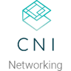



















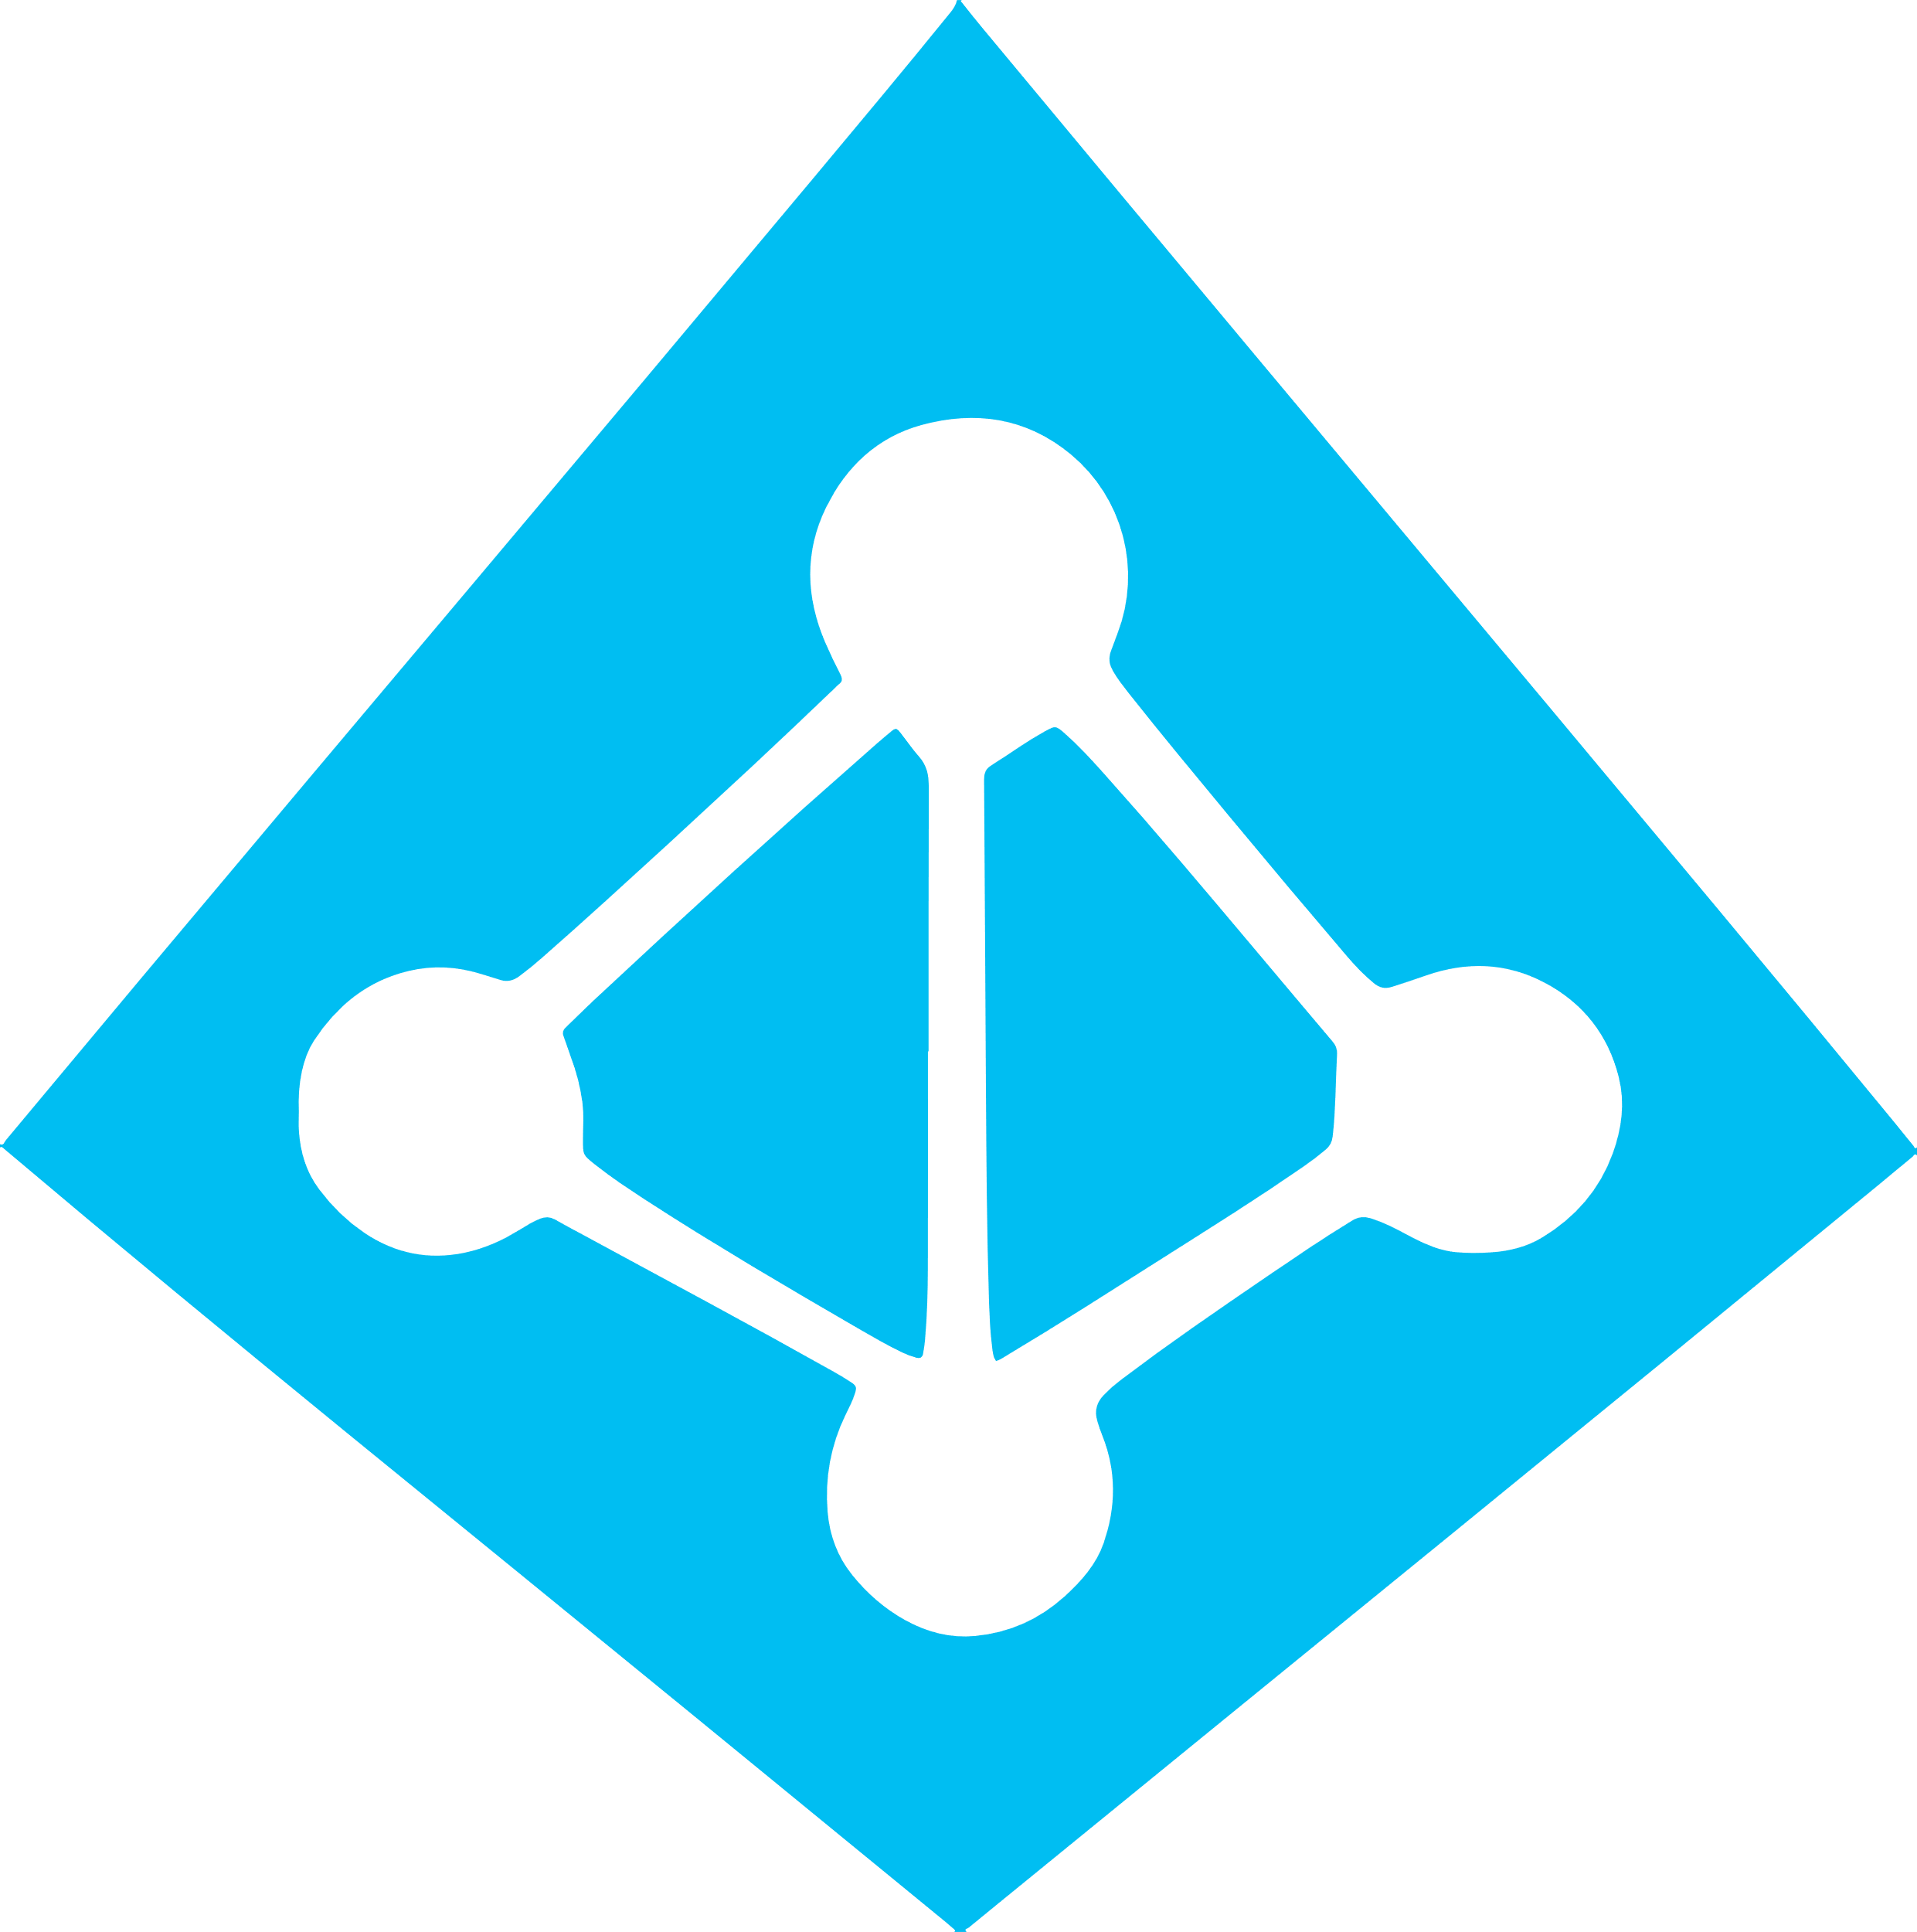
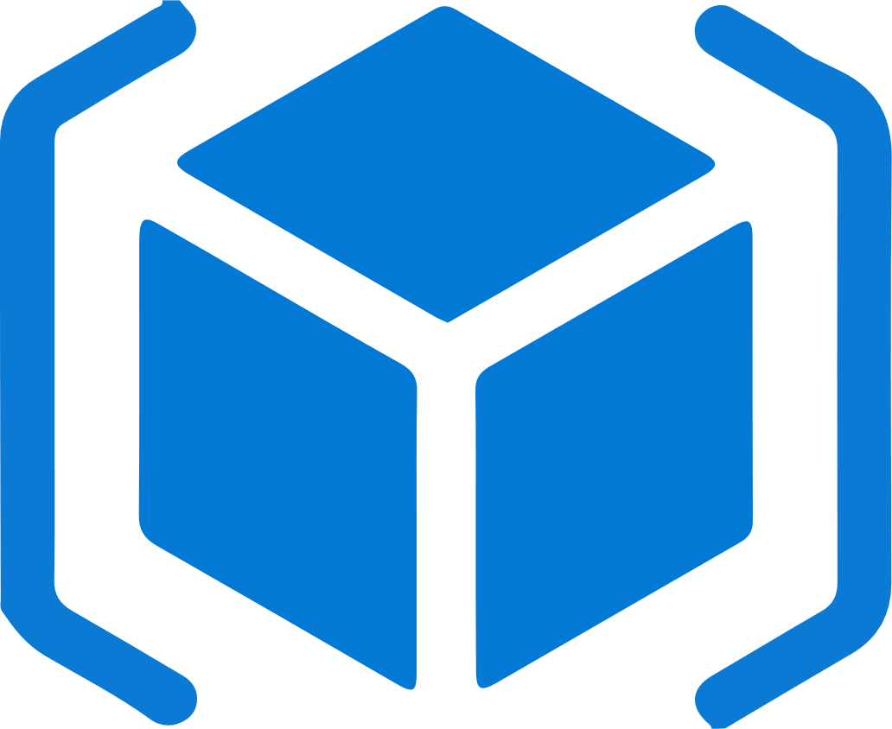

Work how you want with opensource tools and APIs
 | Development | DevOps | Monitoring | Networking | Storage | Security
Take advantage of services and tools in the Kubernetes ecosystem
OR, Leverage growing Azure support
RBAC
Azure Container Registry
AAD
Key Vault
DevOps Projects
VSTS
ARM
VS Code
Azure Monitor
Azure VNET
Azure Storage

Slide 22
Secure your Kubernetes environment
Control access through AAD and RBAC
Safeguard keys and secrets with Key Vault
Secure network communications with VNET and CNI
Compliant Kubernetes service with certifications covering SOC, HIPAA, and PCI

Slide 23
Scale and run applications with confidence
Built-in auto scaling
Global data center to boost performance and reach
Elastically burst from AKS cluster using ACI
Geo-replicated container registry

Slide 24
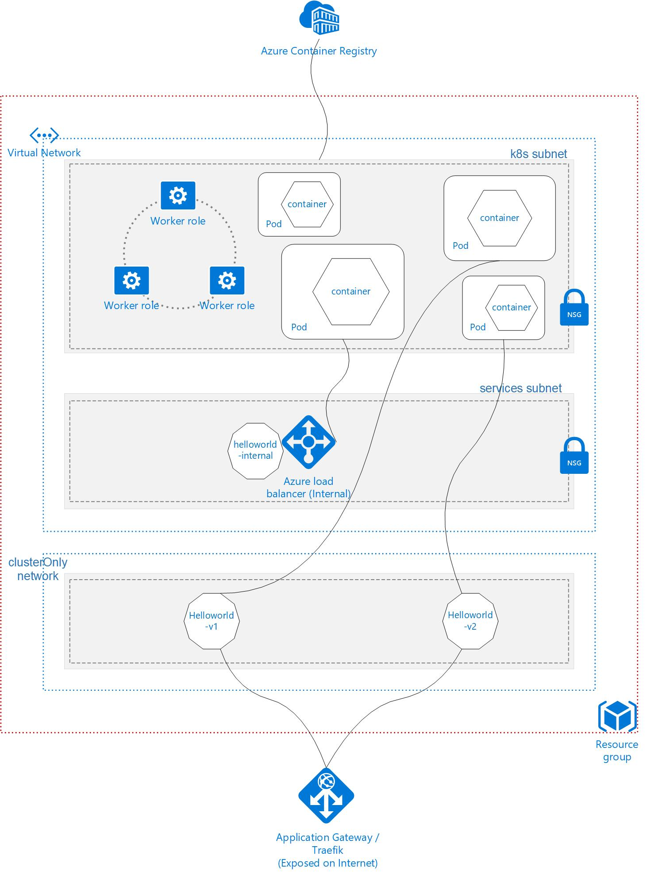
What are we building today?

Slide 25
Top scenarios
Introduction
Top scenarios
Open source culture
Product deep dive
Azure Kubernetes Service Overview
Customer stories
Resources

Slide 26
Top scenarios for Kubernetes on Azure
Lift and shift to containers
Microservices
Machine learning
IoT
Cost saving
without refactoring your app
Agility
Faster application development
Performance
Low latency processing
Portability
Build once, run anywhere

Slide 27
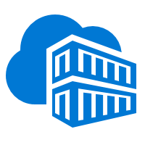
Lift and shift to containers
Microservices
Machine learning
IoT
App modernization without code changes
Speed application deployments by using container technology
Defend against infrastructure failures with container orchestration
Increase agility with continuous integration and continuous delivery
Azure Container Registry
Kubernetes cluster
Existing application
CI/CD
Modernized application
Modernized application
Modernized application
Cloud Database

Slide 28

Lift and shift to containers
Microservices
Machine learning
IoT
Capabilities
Use Azure Container Registry to store container images for your modernized applications, replicated globally with ACR geo-replication
Integrate AKS with Azure Pipelines to enable continuous integration/continuous delivery (CI/CD) using Helm or other Kubernetes ecosystem tooling
Enhance security with Azure Active Directory and RBAC to control access to AKS resources
Easily access to SLA-backed Azure Services such as Azure Database for MySQL using Open Service Broker for Azure (OSBA)
Virtual network
Active Directory
Azure Container Registry
Existing application
Azure Pipelines
Database for MySQL
AKS
OSBA

Slide 29
Lift and shift to containers
Microservices
Machine learning
IoT
Microservices: for faster app development
Monolithic
Microservices
Independent deployments
Improved scale and resource utilization per service
Smaller, focused teams
Large, all-inclusive app
Small, independent services
App
App
App

Slide 30




Lift and shift to containers
Microservices
Machine learning
IoT
Capabilities
Helm chart
Use Azure Dev Spaces to iteratively develop, test, and debug microservices targeted for AKS clusters.
Azure DevOps has native integration with Helm and helps simplifying continuous integration/continuous delivery (CI/CD)
Virtual node—a Virtual Kubelet implementation—allows fast scaling of services for unpredictable traffic using ACI.
Azure Monitor provides a single pane of glass for monitoring over app telemetry, cluster-to-container level health analytics.
4
Inner loop
Azure Container Registry
AKS production cluster
Source code control
Azure Monitor
Pods
Azure DevSpaces
AKS dev cluster
Test
Debug
1
Auto-build
Azure Pipeline/ DevOps Project
2
3
ACI instances
Pods
CI/CD
https://github.com/Microsoft/SmartHotel360-AKS-DevSpaces-Demo

Slide 31
Lift and shift to containers
Microservices
Machine learning
IoT
Data science in a box
Algorithm
Quick deployment and high availability
Low latency data processing
Consistent environment across test, control and production
GPU-enabled VMs
Training data
AKS trained model
AI model in production
Serve the model
Data Scientist
https://github.com/Azure/kubeflow-labs
Compute
Developer
<\>

Slide 32

Lift and shift to containers
Microservices
Machine learning
IoT
App developer
Capabilities
Package ML model into a container and publish to ACR
AKS
6
Query the model for AI features in app
Azure Blob storage hosts training data sets and trained model
ML model in containers
Use Kubeflow to deploy training job to AKS, distributed training job to AKS includes Parameter servers and Worker nodes…
1
Azure Container Registry
Data scientist
3
4
Serve the model in production
Kubeflow
Parameter server nods
Worker nodes
GPU-enabled VMS
Serve production model using Kubeflow, promoting a consistent environment across test, control and production
2
Azure Blob Storage
5
AKS supports GPU enabled VM
Developer can build features querying the model running in AKS cluster
https://github.com/Azure/kubeflow-labs

Slide 33
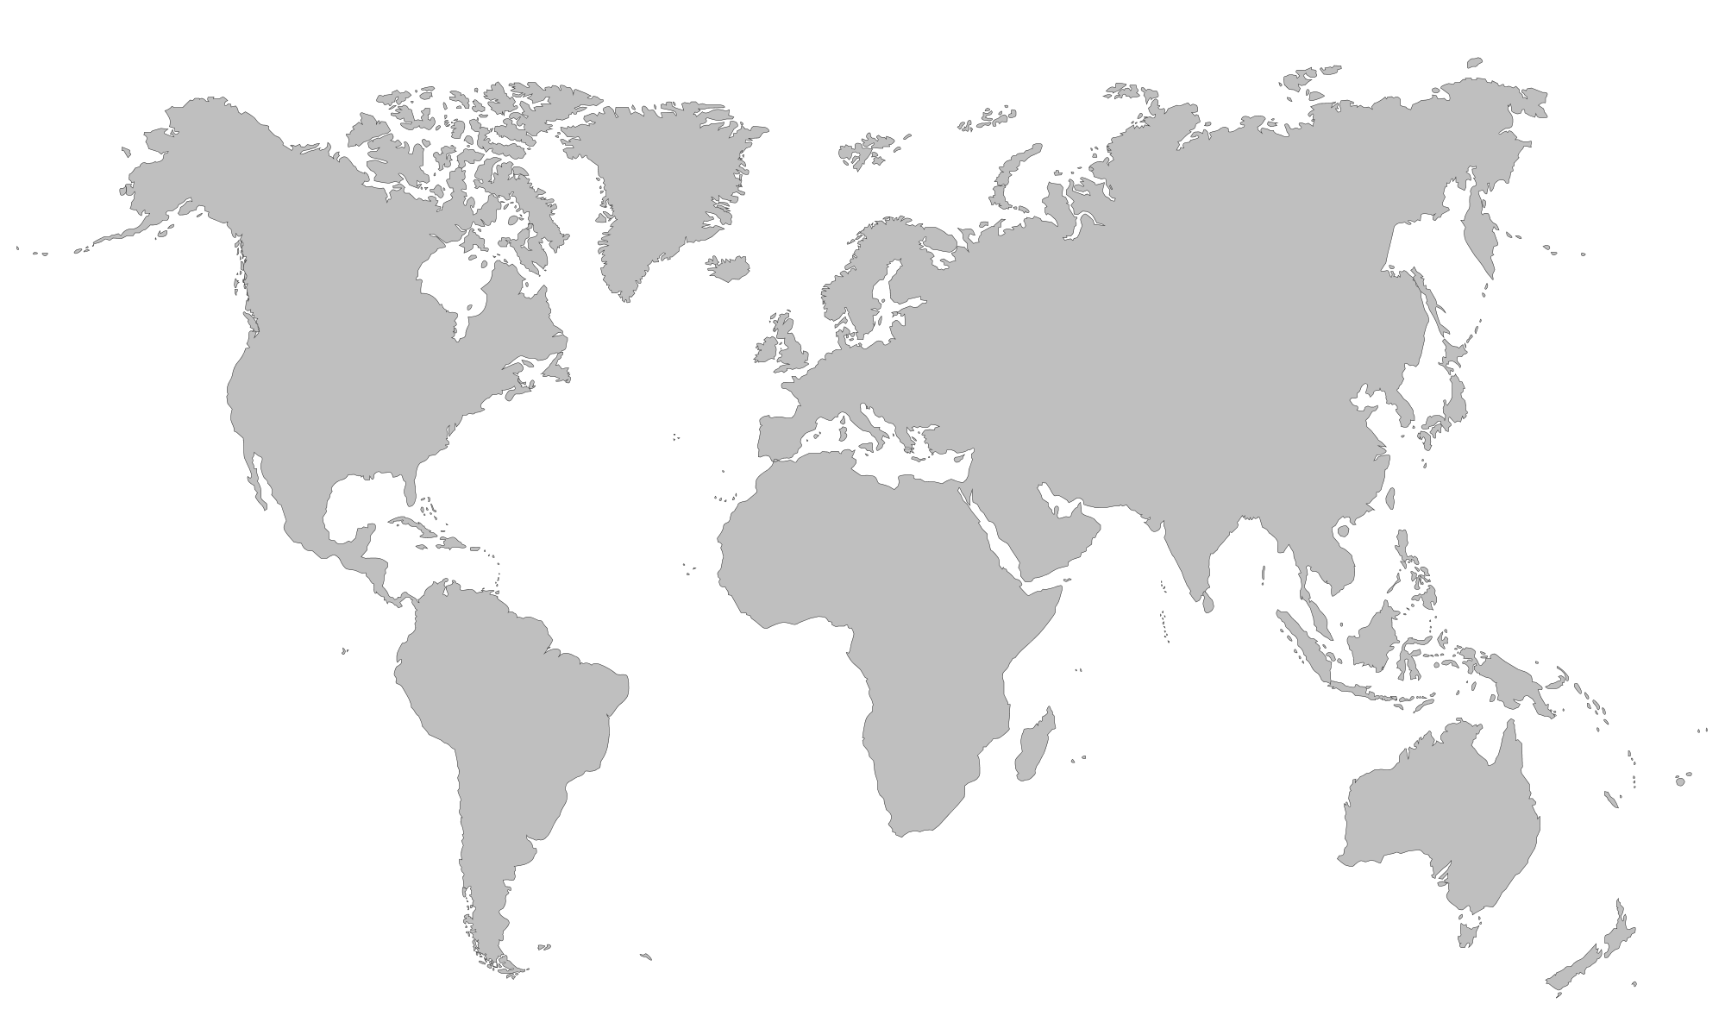



Lift and shift to containers
Microservices
Machine learning
IoT
Scalable Internet of Things solutions
IoT Edge devices
Portable code, runs anywhere
Elastic scalability and manageability
Quick deployment and high availability
AKS
IoT Edge Connector
IoT Hub
SQL Database
Azure Cosmos DB
Database for MySQL

Slide 34
Lift and shift to containers
Microservices
Machine learning
IoT
Capabilities
Azure IoT Edge encrypts data and send to Azure, which then decrypts the data and send to storage
Decrypt
Decompress
Send to Storage
Compress
Encrypt
Send to Cloud
1
Virtual node, an implementation of Virtual Kubelet, serves as the translator between cloud and edge
Azure
Azure IoT Edge
Kubernetes cluster
2
4
IoT Edge Provider in virtual node redirects containers to IoT Edge and extend AKS cluster to target millions of Edge devices
Node
Node
Virtual node
Docker container
Docker container
Docker container
Docker container
Docker container
3
Docker containers
IoT Edge Provider
Consistent update, manage, and monitoring as one unit in AKS using single pod definition

Slide 35
Customer stories
Introduction
Top scenarios
Open source culture
Product deep dive
Azure Kubernetes Service Overview
Customer stories
Resources

Slide 36

Xerox Docushare Flex—Before
Internet
Typical 3-tier architecture using VMs
Each customer instance assigned to dedicated Java and Postgres VMs
Set of backing services for authentication, file sharing, common data sources
Virtual Machines
Customer A
Customer B
Customer C
Java
Java
Java
Postgres
Postgres
Postgres
Problem: Due to overhead and management burden of VMs, adding a new customer takes 24 hours, slowing down customer onboarding through sales and partner network
Backing Services
LDAP
SFTP
PRIZM

Slide 37
Xerox Docushare Flex—After
Internet
Typical 3-tier architecture using AKS
Convert Postgres database to a shared backing service
Run Java application in containers with no code modification
Switch to NGINX-based web-tier with LetsEncrypt for free SSL/TLS
New Helm chart created to automate customer onboarding to AKS
AKS
NGINX
Customer A
Customer B
Customer C
Azure Container Registry
Java
Java
Java
Outcome: Run the Java application in containers on AKS, decreasing provisioning time from 24 hours to 10 minutes, accelerating sales and customer onboarding with no code changes required
Backing Services
LDAP
SFTP
PRIZM
Postgres

Slide 38



Xerox moves to containers in Azure for faster demo environment releases
Benefits: | Onboard prospective customers faster through automation Enable self-service demo environments for large partners Reduce administrative overhead for small Ops team No code modification required
Thanks to Azure Kubernetes Service, we can now spin up new demo environments in 10 minutes instead of 24 hours. Moving Docushare Flex from virtual machines to containers in Azure allows us to provision environments faster, empowering our sales and partner network.”
Robert Bingham, Director of DocuShare Cloud Operations at Xerox

Slide 39


Maersk uses AKS for a customer service process to elevate NSAT, an industry-wide challenge
Needs: | Get near-real-time data to provide better customer service Collect data for future Machine Learning driven features
Challenges: | Compute & memory intensive features Data integration difficulties Limited organisational experience in Cloud & Kubernetes
Requirements: | Spend less time on container software management Automation and continuous delivery Full visibility to application, container and infrastructure Fine grained security and access control
Click icon to learn more

Slide 40

Architectural approach
Azure Pipelines for automation and CI/CD pipelines; adding Terraform for further automation
App Gateway
Key Vault to secure secrets and for persistent configuration store
Firewall
Azure Pipeline
AKS w/ RBAC
Data Factory
Data Management Gateway
On-premises database
Azure Monitor for containers to provide better logging, troubleshooting, with no direct container access
1
4
Express Route
Key Vault
SQL Database
2
SQL Database
Cosmos DB
RBAC control for fine grained Kubernetes resources access control
Azure Monitor
Event Hub
3
Performance Document DB
App Insights
Batch processing
Event Simulation
Service Bus
Internal Queuing

Slide 41
Results
Reduced environment provisioning time from 1+ weeks to 2.5 hours
AKS and CaaS can potentially save 33% on run cost
100% automated production deployments
<\>
Less time spend on managing secrets with AKS and Key Vault
Increased developer autonomy with ARM and terraform

Slide 42


Ambit Energy uses cloud to electrify pace of innovation and expansion
Azure support for Docker, Kubernetes, Puppet, Terraform, Cassandra, and other open source tools has become very important to us and has really accelerated our move into Azure.”
Challenge: | To meet aggressive growth goals, Ambit Energy needed to automate infrastructure provisioning to match their pace of new software creation.
Solution: | To stand up infrastructure quickly, Ambit used Microsoft Azure services such as Azure Container Service, together with infrastructure as code and open source technologies, to completely automate infrastructure provisioning.
Outcome: | By implementing Azure, Ambit can move dramatically faster to enhance its services and enter new markets. Infrastructure redundancy is flexible and worry-free. And costs are 22 percent lower, which helps Ambit compete in the crowded electricity market.
Robert Rudduck, Director of Architecture and DevOps Ambit Energy
Click icon to learn more

Slide 43


Altair Engineering uses cloud to democratize HPC access
Customers are limited as to what they can do on workstations, but with Azure we can give them a scalable, cost-effective back-end HPC infrastructure.”
Challenge: | Altair needed a specialized HPC architecture containing high-performance graphics processing units to deliver their latest topology optimization and analysis application to customers.
Solution: | Altair used Kubernetes in Azure Container Service to handle back-end functions and increase the density of services running across compute nodes.
Outcome: | With Azure, Altair provides customers with a scalable, cost-effective back-end HPC infrastructure, eliminating the need for expensive engineering workstations.
Sam Mahalingam, Chief Technical Officer Cloud Computing and High-Performance Computing Strategy Altair Engineering
Click icon to learn more

Slide 44
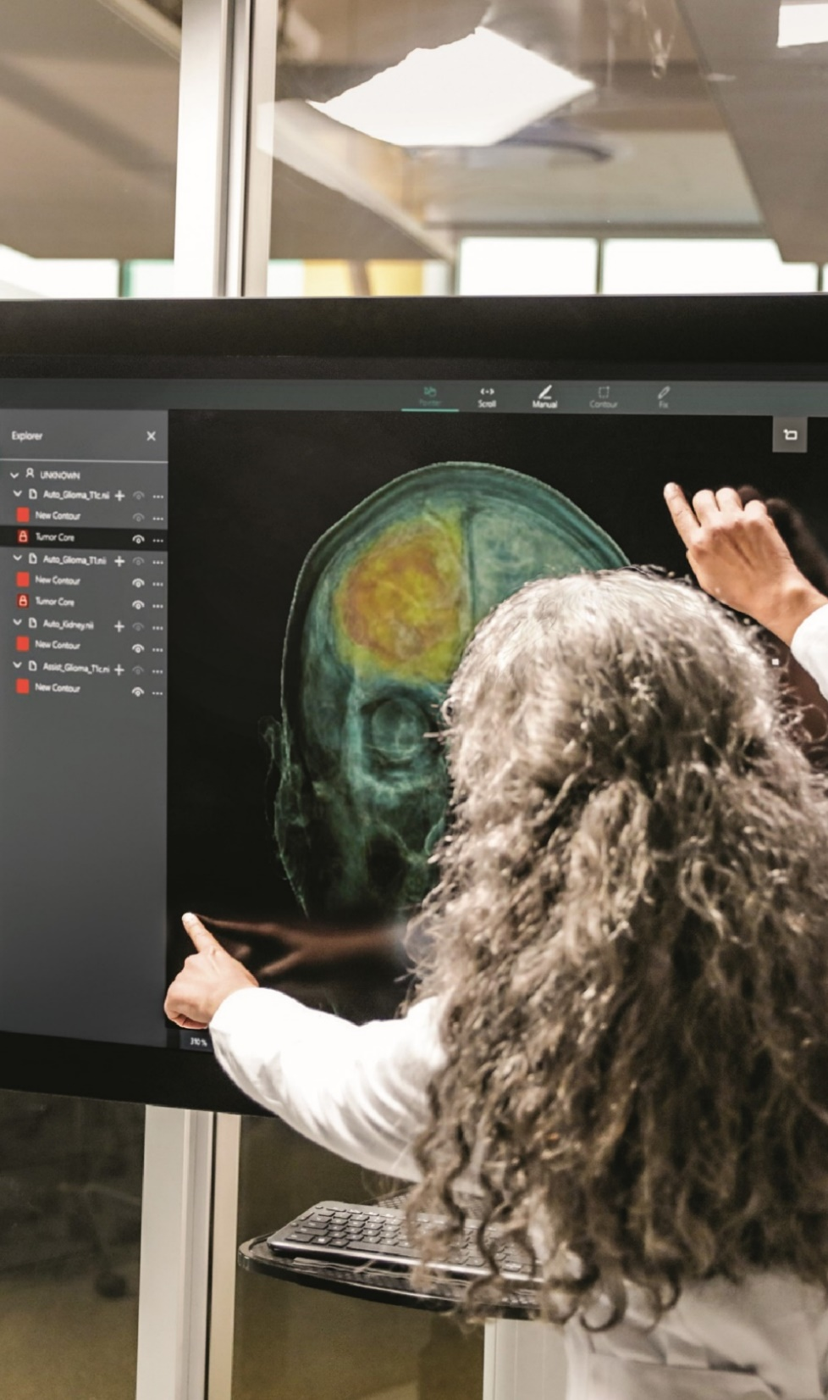

Varian uses cloud and container software technology to streamline IT and focus on innovation
With AKS, developers get a safe place to innovate and to experiment with new technologies and ideas…It’s the best of open service combined with the best of Azure.”
Challenge: | Varian needed to provide broader cancer care and enable faster innovation for the benefit of cancer patients.
Solution: | Varian chose Microsoft Azure as its cloud platform and Azure Kubernetes Service to scale application deployments to thousands of customers, utilizing containers to modernize existing apps and create new ones.
Outcome: | With AKS, Varian’s developers can deliver features to customers quickly and get their feedback without the overhead of provisioning a group of virtual machines.
Shivakumar Gopalakrishnan Senior Manager, Varian Medical Systems
Click icon to learn more

Slide 45


Falkonry uses cloud and machine learning to create a “data scientist in a box”
We’re very happy with the speed of deployment we can offer our customers with Azure. If we had to fly people out to configure and set up hardware and software, we would lose several weeks in the process.”
Challenge: | Falkonry needed a solution to scale the deployment of its machine learning application to reach customers in the oil and gas industries.
Solution: | Falkonry used Azure Kubernetes Service to automate the deployment of Kubernetes clusters to deliver their application globally.
Outcome: | With Azure Kubernetes Service, Falkonry is able to deploy their solutions in days, compared to months it takes for companies using a more traditional platform approach.
Sanket Amberkar, Senior VP of Marketing Falkonry
Click icon to learn more

Slide 46


OpenAI uses cloud to drive flexibility and scalability for deep learning experiments
Because Kubernetes provides a consistent API, we can move our research experiments very easily between clusters… [We] have a number of teams that run their experiments both in Azure and in our own data centers, just depending on which cluster has free capacity, and that's hugely valuable.”
Challenge: | OpenAI needed infrastructure for deep learning that would allow experiments to run either in the cloud or in its own data center, and to easily scale.
Solution: | OpenAI migrated its Kubernetes clusters to Azure, running key experiments in fields including robotics and gaming both in Azure and in its own data centers.
Outcome: | Researchers now spend far less time launching experiments and scaling them out to hundreds of GPUs. OpenAI has also benefited from greater portability and lower costs given the ability to use its own data centers when appropriate.
Christopher Berner, Head of Infrastructure OpenAI
Click icon to learn more

Slide 47

Open source culture
Introduction
Top scenarios
Open source culture
Product deep dive
Azure Kubernetes Service Overview
Customer stories
Resources

Slide 48





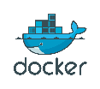
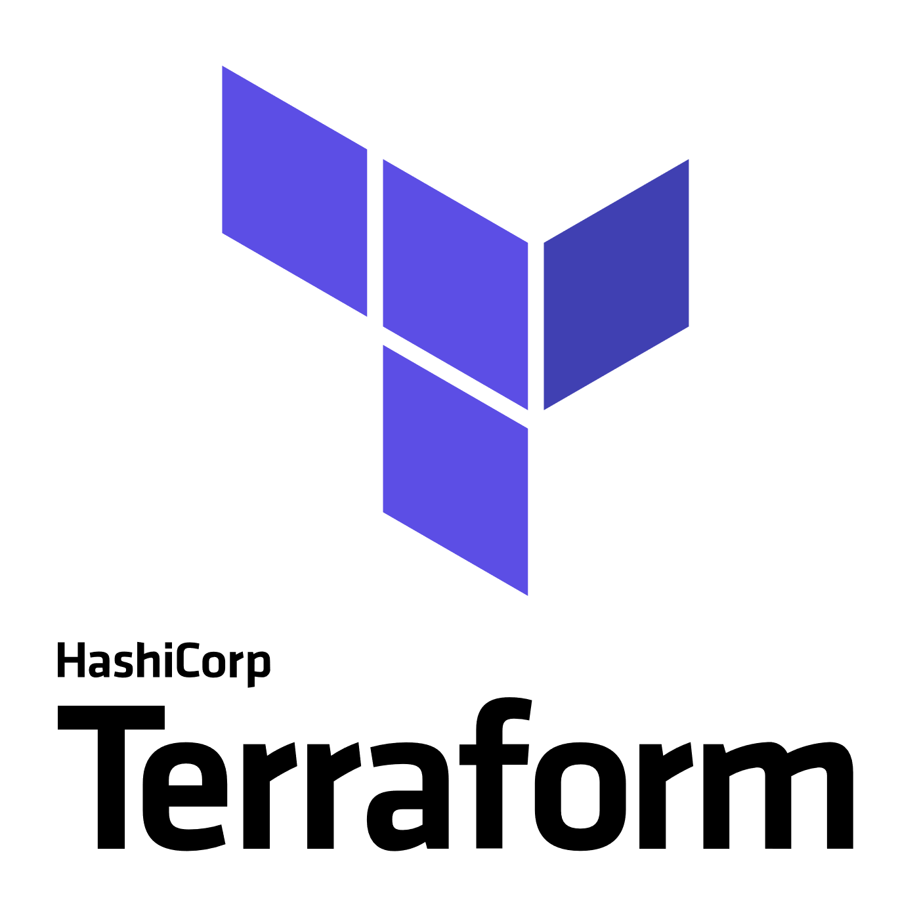


Azure + open source momentum
Azure is a strong platform for Open Source
Linux VMs are growing at ~2 times Windows VMs today
Microsoft announced GitHub acquisition
1 in 3 VMs on Azure are Linux
~60% of 3rd party Azure Marketplace images are open source
Partnerships
“Microsoft Joins Cloud Native Computing Foundation as Platinum Member”

Slide 49
Microsoft contributes open source containers
#2 overall individual contributor to Kubernetes (Brendan Burns)
#4 overall individual contributor to Docker (John Howard)
#1-3 overall individual contributors to Helm
70 Microsoft employees have made contributions to Kubernetes

Slide 50
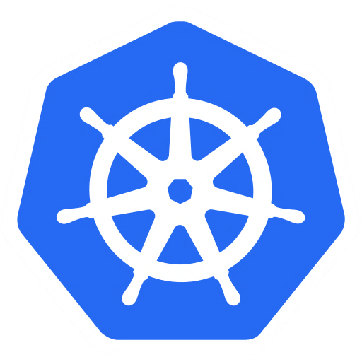

Microsoft leads open source communities
Two members of the Kubernetes steering committee
Member of the technical board of the Cloud Native Compute Foundation
Board member of the Linux Foundation
Several leads or co-leads of Kubernetes SIGs (special interest groups)

Slide 51

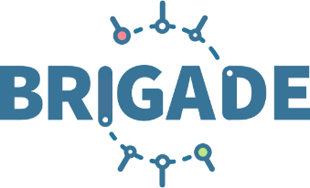
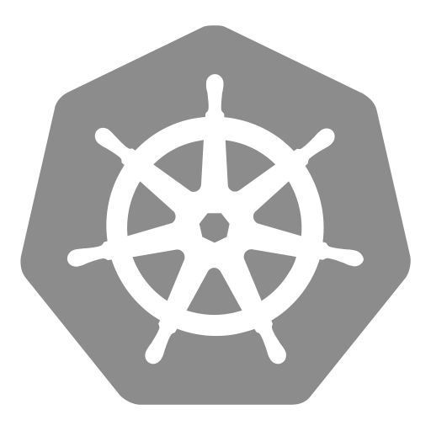

Microsoft builds open source projects
Helm – The de-facto package manager for kubernetes (https://helm.sh), Top level CNCF project
Draft – A rapid-development environment for new kubernetes developers (https://draft.sh)
Brigade – Easy to use javascript based workflow definition for kubernetes (https://brigade.sh)
Kubernetes + VS-Code (https://github.com/Azure/vscode-kubernetes-tools )

Slide 52
Resources
Introduction
Top scenarios
Open source culture
Product deep dive
Azure Kubernetes Service Overview
Customer stories
Resources

Slide 53
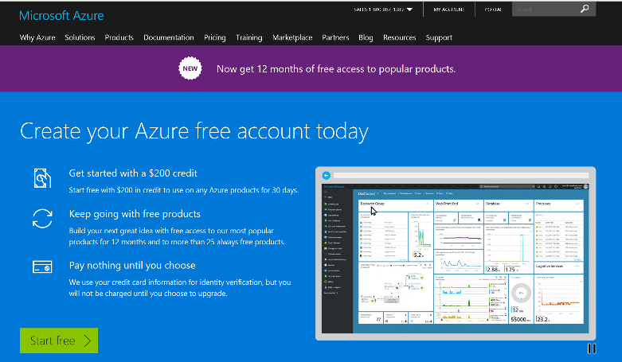
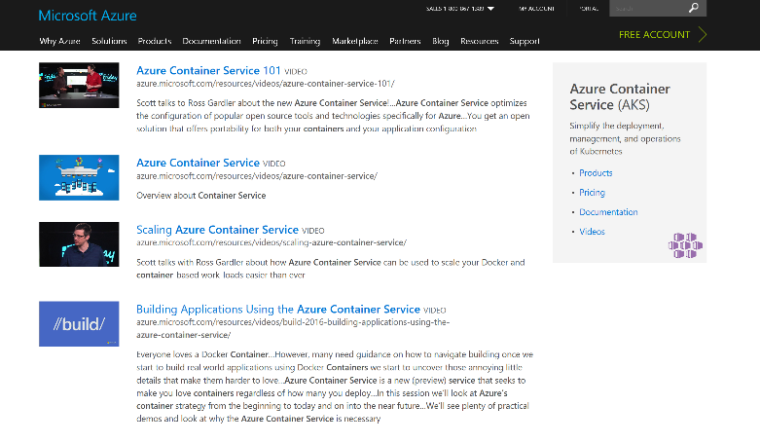
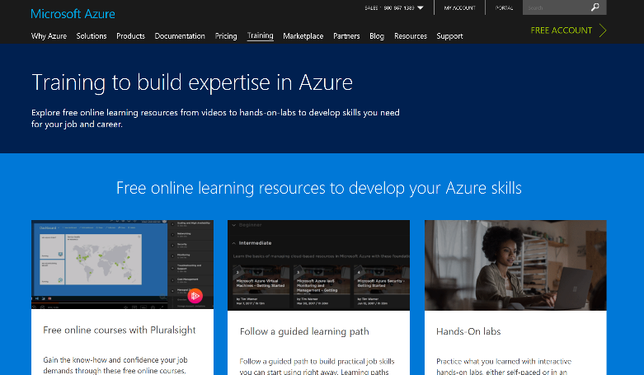
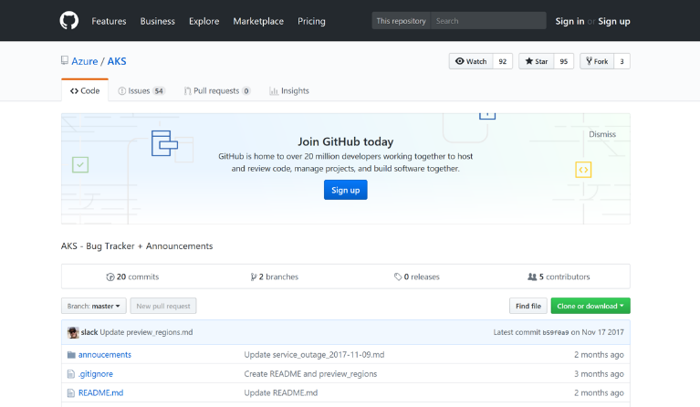
AKS resources
Azure Kubernetes Service (AKS)
Containers on Azure pitch deck
Smart Hotel 360 Demo
Documentation resources
Ebook for distributed systems
Distributed system HoL
AKS HoL
Sign up for a free Azure account
Check out the Azure container videos page
Hone your skills with Azure training
Get the code from GitHub

Slide 54
Product deep dive
Introduction
Top scenarios
Open source culture
Product deep dive
Azure Kubernetes Service Overview
Customer stories
Resources

Slide 55
Azure Container Registry – vulnerability scanning
Developer/CI system builds container image
1
Image pushed to Azure Container Registry
Container image
Developer
Azure Container Registry
4
2
Fails
Aqua and Twistlock container security
Azure Container Registry quarantines image until scanning passes
3
Passes
5
Azure Container Registry scans content leveraging Aqua, Twistlock
Repository
Azure Container Registry publishes the image to the repository

Slide 56
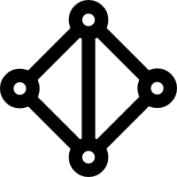
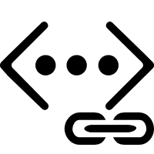
Secure network communications with VNET and CNI
Uses Azure subnet for both your containers and cluster VMs
1
Azure VNet A
Allows for connectivity to existing Azure services in the same VNET
Backend services subnet
AKS subnet
Use Express Route to connect to on-premises infrastructure VNET peering to other VNET
AKS cluster
SQL Server
On-premises infrastructure
Enterprise system
2
Azure Express Route
2
AKS VNet integration works seamlessly with your existing network infrastructure
VNet peering
VNet B
Other peered VNets
3

Slide 57
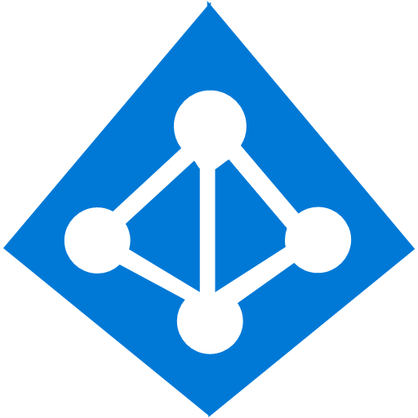
Identity and access management through AAD and RBAC
The client application authenticates to the AAD token issuance endpoint and requests an access token
Azure Active Directory
The AAD token issuance endpoint issues the access token
1
The access token is used to authenticate to the secured resource
Client application
Token
2
AKS
Data from the secured resource is returned to the web application
3
Token
Azure delivers a streamlined identity and access management solution with Azure Active Directory (AAD) and Azure Kubernetes Services (AKS)
4

Slide 58
Pod identity
Kubernetes operator defines an identity map for K8s service accounts
Developer
<\>
Node Managed Identity (NMI) watches for mapping reaction and syncs to Managed Service Identify (MSI)
3
Kubernetes
Kubernetes controller
Azure Identity Binding
Azure SQL Server
1
Pod
Developer creates a pod with a service account, and pod uses standard Azure SDK to fetch a token bound to MSI
Active Directory Pod Identity
Token
Azure MSI
Pod uses access token to consume other Azure services; services validate token
4
NMI + EMSI
2

